Slide 1
CS 412 Intro. to Data Mining
Chapter 1. Introduction
Jiawei Han, Computer Science, Univ. Illinois at Urbana-Champaign, 2106

Slide 2

August 27, 2016
Data Mining: Concepts and Techniques
2
Notes:
2

Slide 3





Data and Information Systems (DAIS)
Database Systems
Data Mining
Text Information Systems
Networks
_{Kevin Chang}
_{Aditya}
_{Parameswaran}
_{Jiawei Han}
_{Hari Sundaram}
_{ChengXiang}
_{Zhai}

Slide 4
Data and Information Systems (DAIS:) Course Structures at CS/UIUC
Coverage: Database, data mining, text information systems, Web and bioinformatics
Data mining
Intro. to data warehousing and mining (CS412)
Data mining: Principles and algorithms (CS512)
Database Systems:
Intro. to database systems (CS411)
Advanced database systems (CS511)
Text information systems
Text information system (CS410)
Advanced text information systems (CS510)

Slide 5
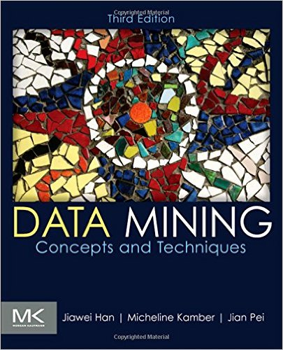
CS 412. Course Page & Class Schedule
Textbook
Jiawei Han, Micheline Kamber and Jian Pei, Data Mining: Concepts and Techniques (3rd ed), Morgan Kaufmann, 2011
Class Homepage: https://wiki.engr.illinois.edu/display/cs412
Bookmark on course schedule page
Class Schedule: 11-12:15pm Tues./Thurs.@1404 SC
Office hours: 12:15-1pm Tues./Thurs. @2132 SC
Lecture media: recorded; but Class attendance is critical

Slide 6




CS 412. Fall 2016. Teach Assistants
Po-Wei Chan
Huan Gui
Brandon Norick
Keyang Zhang
TA office hours: 4-5pm (Mon.), 5-6pm (Wed.) @0207SC. Additional hours before due date will be announced at Piazza
Wait list: https://my.cs.illinois.edu/undergraduate/waitlist
If you cannot register but still desperately want to take the course,
Please sign your name on the waiting list: Explain why you have to take it this Fall

Slide 7
CS 412. Course Work and Grading
Assignments, Programming Assignments, and Exams
Written Assignments: 15% (three homework assignments expected)
Programming assignments: 20% (two programming assignments expected)
Midterm exam: 30%
Final exam: 35%
For students taking 4th credit (TA will provide concrete instructions on the 4th credit project)
For students registering 4 credits: 25%. The overall scores will be scaled proportionally
Need help and/or discussions?
Sign on: Piazza (https://piazza.com/illinois/cs412)
Check your homework/exam scores:
Compass

Slide 8
Chapter 1. Introduction
Why Data Mining?
What Is Data Mining?
A Multi-Dimensional View of Data Mining
What Kinds of Data Can Be Mined?
What Kinds of Patterns Can Be Mined?
What Kinds of Technologies Are Used?
What Kinds of Applications Are Targeted?
Major Issues in Data Mining
A Brief History of Data Mining and Data Mining Society
Summary

Slide 9
Why Data Mining?
The Explosive Growth of Data: from terabytes to petabytes
Data collection and data availability
Automated data collection tools, database systems, Web, computerized society
Major sources of abundant data
Business: Web, e-commerce, transactions, stocks, …
Science: Remote sensing, bioinformatics, scientific simulation, …
Society and everyone: news, digital cameras, YouTube
We are drowning in data, but starving for knowledge!
“Necessity is the mother of invention”—Data mining—Automated analysis of massive data sets

Slide 10
Chapter 1. Introduction
Why Data Mining?
What Is Data Mining?
A Multi-Dimensional View of Data Mining
What Kinds of Data Can Be Mined?
What Kinds of Patterns Can Be Mined?
What Kinds of Technologies Are Used?
What Kinds of Applications Are Targeted?
Major Issues in Data Mining
A Brief History of Data Mining and Data Mining Society
Summary

Slide 11
What Is Data Mining?
Data mining (knowledge discovery from data)
Extraction of interesting (non-trivial, implicit, previously unknown and potentially useful) patterns or knowledge from huge amount of data
Data mining: a misnomer?
Alternative names
Knowledge discovery (mining) in databases (KDD), knowledge extraction, data/pattern analysis, data archeology, data dredging, information harvesting, business intelligence, etc.
Watch out: Is everything “data mining”?
Simple search and query processing
(Deductive) expert systems

Slide 12
Knowledge Discovery (KDD) Process
Knowledge
This is a view from typical database systems and data warehousing communities
Data mining plays an essential role in the knowledge discovery process
Pattern Evaluation
Data Mining
Task-relevant Data
Data Warehouse
Selection
Data Cleaning
Data Integration
Databases

Slide 13
Example: A Web Mining Framework
Web mining usually involves
Data cleaning
Data integration from multiple sources
Warehousing the data
Data cube construction
Data selection for data mining
Data mining
Presentation of the mining results
Patterns and knowledge to be used or stored into knowledge-base

Slide 14
Data Mining in Business Intelligence
Increasing potential
to support
business decisions
End User
Decision Making
Data Presentation
Business
Analyst
Visualization Techniques
Data Mining
Data
Analyst
Information Discovery
Data Exploration
Statistical Summary, Querying, and Reporting
Data Preprocessing/Integration, Data Warehouses
Data Sources
DBA
Paper, Files, Web documents, Scientific experiments, Database Systems

Slide 15
KDD Process: A View from ML and Statistics
Pattern
Information
Knowledge
Input Data
Data Pre-Processing
Data Mining
Post-Processing
Data integration
Normalization
Feature selection
Dimension reduction
Pattern discovery
Classification
Clustering
Outlier analysis
… … … …
Pattern evaluation
Pattern selection
Pattern interpretation
Pattern visualization
This is a view from typical machine learning and statistics communities

Slide 16
Data Mining vs. Data Exploration
Which view do you prefer?
KDD vs. ML/Stat. vs. Business Intelligence
Depending on the data, applications, and your focus
Data Mining vs. Data Exploration
Business intelligence view
Warehouse, data cube, reporting but not much mining
Business objects vs. data mining tools
Supply chain example: mining vs. OLAP vs. presentation tools
Data presentation vs. data exploration

Slide 17
Chapter 1. Introduction
Why Data Mining?
What Is Data Mining?
A Multi-Dimensional View of Data Mining
What Kinds of Data Can Be Mined?
What Kinds of Patterns Can Be Mined?
What Kinds of Technologies Are Used?
What Kinds of Applications Are Targeted?
Major Issues in Data Mining
A Brief History of Data Mining and Data Mining Society
Summary

Slide 18
Multi-Dimensional View of Data Mining
Data to be mined
Database data (extended-relational, object-oriented, heterogeneous), data warehouse, transactional data, stream, spatiotemporal, time-series, sequence, text and web, multi-media, graphs & social and information networks
Knowledge to be mined (or: Data mining functions)
Characterization, discrimination, association, classification, clustering, trend/deviation, outlier analysis, …
Descriptive vs. predictive data mining
Multiple/integrated functions and mining at multiple levels
Techniques utilized
Data-intensive, data warehouse (OLAP), machine learning, statistics, pattern recognition, visualization, high-performance, etc.
Applications adapted
Retail, telecommunication, banking, fraud analysis, bio-data mining, stock market analysis, text mining, Web mining, etc.

Slide 19
Chapter 1. Introduction
Why Data Mining?
What Is Data Mining?
A Multi-Dimensional View of Data Mining
What Kinds of Data Can Be Mined?
What Kinds of Patterns Can Be Mined?
What Kinds of Technologies Are Used?
What Kinds of Applications Are Targeted?
Major Issues in Data Mining
A Brief History of Data Mining and Data Mining Society
Summary

Slide 20
Data Mining: On What Kinds of Data?
Database-oriented data sets and applications
Relational database, data warehouse, transactional database
Object-relational databases, Heterogeneous databases and legacy databases
Advanced data sets and advanced applications
Data streams and sensor data
Time-series data, temporal data, sequence data (incl. bio-sequences)
Structure data, graphs, social networks and information networks
Spatial data and spatiotemporal data
Multimedia database
Text databases
The World-Wide Web

Slide 21
Chapter 1. Introduction
Why Data Mining?
What Is Data Mining?
A Multi-Dimensional View of Data Mining
What Kinds of Data Can Be Mined?
What Kinds of Patterns Can Be Mined?
What Kinds of Technologies Are Used?
What Kinds of Applications Are Targeted?
Major Issues in Data Mining
A Brief History of Data Mining and Data Mining Society
Summary

Slide 22
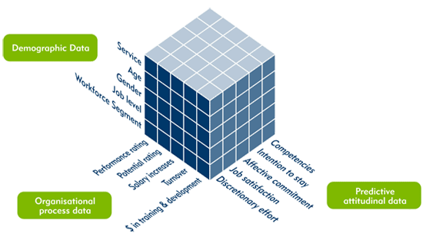
Data Mining Functions: (1) Generalization
Information integration and data warehouse construction
Data cleaning, transformation, integration, and multidimensional data model
Data cube technology
Scalable methods for computing (i.e., materializing) multidimensional aggregates
OLAP (online analytical processing)
Multidimensional concept description: Characterization and discrimination
Generalize, summarize, and contrast data characteristics, e.g., dry vs. wet region

Slide 23
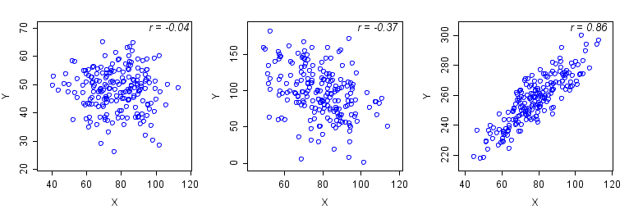
Data Mining Functions: (2) Pattern Discovery
Frequent patterns (or frequent itemsets)
What items are frequently purchased together in your Walmart?
Association and Correlation Analysis
A typical association rule
Diaper → Beer [0.5%, 75%] (support, confidence)
Are strongly associated items also strongly correlated?
How to mine such patterns and rules efficiently in large datasets?
How to use such patterns for classification, clustering, and other applications?

Slide 24
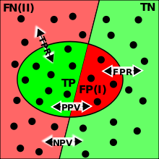
Data Mining Functions: (3) Classification
Classification and label prediction
Construct models (functions) based on some training examples
Describe and distinguish classes or concepts for future prediction
Ex. 1. Classify countries based on (climate)
Ex. 2. Classify cars based on (gas mileage)
Predict some unknown class labels
Typical methods
Decision trees, naïve Bayesian classification, support vector machines, neural networks, rule-based classification, pattern-based classification, logistic regression, …
Typical applications:
Credit card fraud detection, direct marketing, classifying stars, diseases, web-pages, …

Slide 25
Data Mining Functions: (4) Cluster Analysis
Unsupervised learning (i.e., Class label is unknown)
Group data to form new categories (i.e., clusters), e.g., cluster houses to find distribution patterns
Principle: Maximizing intra-class similarity & minimizing interclass similarity
Many methods and applications

Slide 26
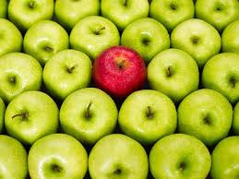
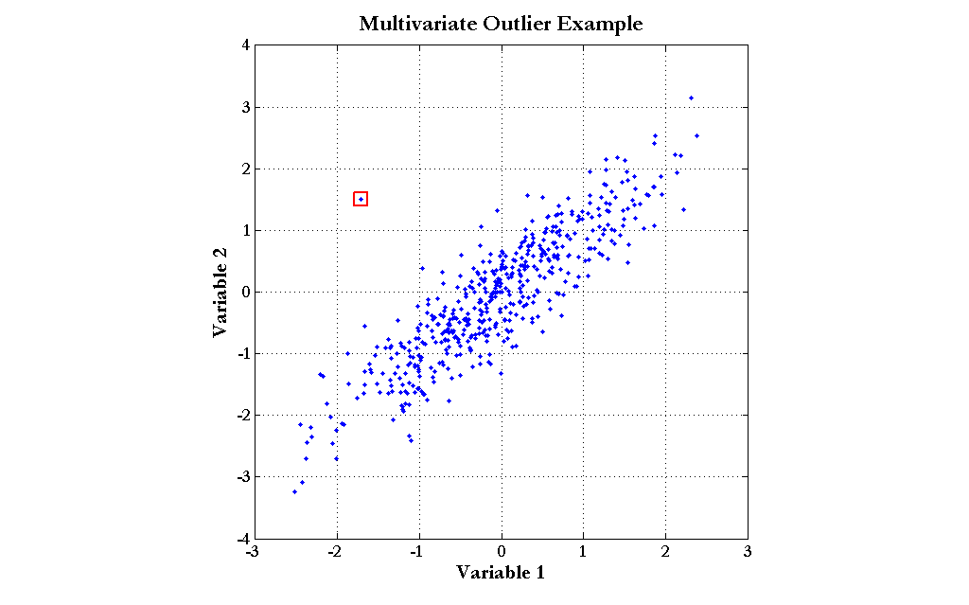
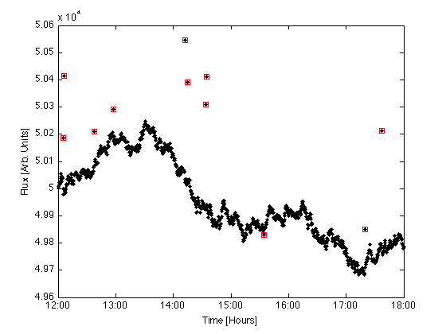
Data Mining Functions: (5) Outlier Analysis
Outlier analysis
Outlier: A data object that does not comply with the general behavior of the data
Noise or exception?―One person’s garbage could be another person’s treasure
Methods: by product of clustering or regression analysis, …
Useful in fraud detection, rare events analysis

Slide 27

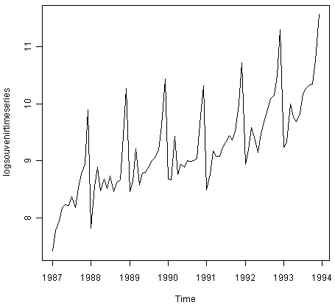
Data Mining Functions: (6) Time and Ordering: Sequential Pattern, Trend and Evolution Analysis
Sequence, trend and evolution analysis
Trend, time-series, and deviation analysis
e.g., regression and value prediction
Sequential pattern mining
e.g., buy digital camera, then buy large memory cards
Periodicity analysis
Motifs and biological sequence analysis
Approximate and consecutive motifs
Similarity-based analysis
Mining data streams
Ordered, time-varying, potentially infinite, data streams

Slide 28
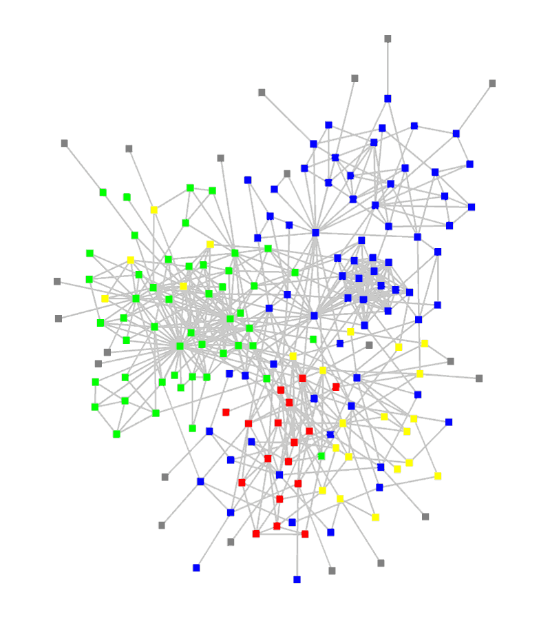
Data Mining Functions: (7) Structure and Network Analysis
Graph mining
Finding frequent subgraphs (e.g., chemical compounds), trees (XML), substructures (web fragments)
Information network analysis
Social networks: actors (objects, nodes) and relationships (edges)
e.g., author networks in CS, terrorist networks
Multiple heterogeneous networks
A person could be multiple information networks: friends, family, classmates, …
Links carry a lot of semantic information: Link mining
Web mining
Web is a big information network: from PageRank to Google
Analysis of Web information networks
Web community discovery, opinion mining, usage mining, …

Slide 29

Evaluation of Knowledge
Are all mined knowledge interesting?
One can mine tremendous amount of “patterns”
Some may fit only certain dimension space (time, location, …)
Some may not be representative, may be transient, …
Evaluation of mined knowledge → directly mine only interesting knowledge?
Descriptive vs. predictive
Coverage
Typicality vs. novelty
Accuracy
Timeliness
…

Slide 30
Chapter 1. Introduction
Why Data Mining?
What Is Data Mining?
A Multi-Dimensional View of Data Mining
What Kinds of Data Can Be Mined?
What Kinds of Patterns Can Be Mined?
What Kinds of Technologies Are Used?
What Kinds of Applications Are Targeted?
Major Issues in Data Mining
A Brief History of Data Mining and Data Mining Society
Summary

Slide 31
Data Mining: Confluence of Multiple Disciplines
Machine
Learning
Pattern
Recognition
Statistics
Applications
Data Mining
Visualization
Algorithm
Database
Technology
High-Performance
Computing

Slide 32
Why Confluence of Multiple Disciplines?
Tremendous amount of data
Algorithms must be scalable to handle big data
High-dimensionality of data
Micro-array may have tens of thousands of dimensions
High complexity of data
Data streams and sensor data
Time-series data, temporal data, sequence data
Structure data, graphs, social and information networks
Spatial, spatiotemporal, multimedia, text and Web data
Software programs, scientific simulations
New and sophisticated applications
Notes:
Add a definition/description of “traditional data analysis”.

Slide 33
Chapter 1. Introduction
Why Data Mining?
What Is Data Mining?
A Multi-Dimensional View of Data Mining
What Kinds of Data Can Be Mined?
What Kinds of Patterns Can Be Mined?
What Kinds of Technologies Are Used?
What Kinds of Applications Are Targeted?
Major Issues in Data Mining
A Brief History of Data Mining and Data Mining Society
Summary

Slide 34

Applications of Data Mining
Web page analysis: classification, clustering, ranking
Collaborative analysis & recommender systems
Basket data analysis to targeted marketing
Biological and medical data analysis
Data mining and software engineering
Data mining and text analysis
Data mining and social and information network analysis
Built-in (invisible data mining) functions in Google, MS, Yahoo!, Linked, Facebook, …
Major dedicated data mining systems/tools
SAS, MS SQL-Server Analysis Manager, Oracle Data Mining Tools)

Slide 35
Chapter 1. Introduction
Why Data Mining?
What Is Data Mining?
A Multi-Dimensional View of Data Mining
What Kinds of Data Can Be Mined?
What Kinds of Patterns Can Be Mined?
What Kinds of Technologies Are Used?
What Kinds of Applications Are Targeted?
Major Issues in Data Mining
A Brief History of Data Mining and Data Mining Society
Summary

Slide 36
Major Issues in Data Mining (1)
Mining Methodology
Mining various and new kinds of knowledge
Mining knowledge in multi-dimensional space
Data mining: An interdisciplinary effort
Boosting the power of discovery in a networked environment
Handling noise, uncertainty, and incompleteness of data
Pattern evaluation and pattern- or constraint-guided mining
User Interaction
Interactive mining
Incorporation of background knowledge
Presentation and visualization of data mining results

Slide 37
Major Issues in Data Mining (2)
Efficiency and Scalability
Efficiency and scalability of data mining algorithms
Parallel, distributed, stream, and incremental mining methods
Diversity of data types
Handling complex types of data
Mining dynamic, networked, and global data repositories
Data mining and society
Social impacts of data mining
Privacy-preserving data mining
Invisible data mining

Slide 38
Chapter 1. Introduction
Why Data Mining?
What Is Data Mining?
A Multi-Dimensional View of Data Mining
What Kinds of Data Can Be Mined?
What Kinds of Patterns Can Be Mined?
What Kinds of Technologies Are Used?
What Kinds of Applications Are Targeted?
Major Issues in Data Mining
A Brief History of Data Mining and Data Mining Society
Summary

Slide 39
A Brief History of Data Mining Society
1989 IJCAI Workshop on Knowledge Discovery in Databases
Knowledge Discovery in Databases (G. Piatetsky-Shapiro and W. Frawley, 1991)
1991-1994 Workshops on Knowledge Discovery in Databases
Advances in Knowledge Discovery and Data Mining (U. Fayyad, G. Piatetsky-Shapiro, P. Smyth, and R. Uthurusamy, 1996)
1995-1998 International Conferences on Knowledge Discovery in Databases and Data Mining (KDD’95-98)
Journal of Data Mining and Knowledge Discovery (1997)
ACM SIGKDD conferences since 1998 and SIGKDD Explorations
More conferences on data mining
PAKDD (1997), PKDD (1997), SIAM-Data Mining (2001), (IEEE) ICDM (2001), WSDM (2008), etc.
ACM Transactions on KDD (2007)

Slide 40
Conferences and Journals on Data Mining
KDD Conferences
ACM SIGKDD Int. Conf. on Knowledge Discovery in Databases and Data Mining (KDD)
SIAM Data Mining Conf. (SDM)
(IEEE) Int. Conf. on Data Mining (ICDM)
European Conf. on Machine Learning and Principles and practices of Knowledge Discovery and Data Mining (ECML-PKDD)
Pacific-Asia Conf. on Knowledge Discovery and Data Mining (PAKDD)
Int. Conf. on Web Search and Data Mining (WSDM)
Other related conferences
DB conferences: ACM SIGMOD, VLDB, ICDE, EDBT, ICDT, …
Web and IR conferences: WWW, SIGIR, WSDM
ML conferences: ICML, NIPS
PR conferences: CVPR,
Journals
Data Mining and Knowledge Discovery (DAMI or DMKD)
IEEE Trans. On Knowledge and Data Eng. (TKDE)
KDD Explorations
ACM Trans. on KDD

Slide 41
Where to Find References? DBLP, CiteSeer, Google
Data mining and KDD (SIGKDD)
Conferences: ACM-SIGKDD, IEEE-ICDM, SIAM-DM, PKDD, PAKDD, etc.
Journal: Data Mining and Knowledge Discovery, KDD Explorations, ACM TKDD
Database systems (SIGMOD)
Conferences: ACM-SIGMOD, ACM-PODS, VLDB, IEEE-ICDE, EDBT, ICDT, DASFAA
Journals: IEEE-TKDE, ACM-TODS/TOIS, JIIS, J. ACM, VLDB J., Info. Sys., etc.
AI & Machine Learning
Conferences: Machine learning (ML), AAAI, IJCAI, COLT (Learning Theory), CVPR, NIPS, etc.
Journals: Machine Learning, Artificial Intelligence, Knowledge and Information Systems, IEEE-PAMI, etc.
Web and IR
Conferences: SIGIR, WWW, CIKM, etc.
Journals: WWW: Internet and Web Information Systems,
Statistics
Conferences: Joint Stat. Meeting, etc.
Journals: Annals of statistics, etc.
Visualization
Conference proceedings: CHI, ACM-SIGGraph, etc.
Journals: IEEE Trans. visualization and computer graphics, etc.

Slide 42
Chapter 1. Introduction
Why Data Mining?
What Is Data Mining?
A Multi-Dimensional View of Data Mining
What Kinds of Data Can Be Mined?
What Kinds of Patterns Can Be Mined?
What Kinds of Technologies Are Used?
What Kinds of Applications Are Targeted?
Major Issues in Data Mining
A Brief History of Data Mining and Data Mining Society
Summary

Slide 43
Summary
Data mining: Discovering interesting patterns and knowledge from massive amount of data
A natural evolution of science and information technology, in great demand, with wide applications
A KDD process includes data cleaning, data integration, data selection, transformation, data mining, pattern evaluation, and knowledge presentation
Mining can be performed in a variety of data
Data mining functionalities: characterization, discrimination, association, classification, clustering, trend and outlier analysis, etc.
Data mining technologies and applications
Major issues in data mining

Slide 44
Recommended Reference Books
Charu C. Aggarwal, Data Mining: The Textbook, Springer, 2015
E. Alpaydin. Introduction to Machine Learning, 2nd ed., MIT Press, 2011
R. O. Duda, P. E. Hart, and D. G. Stork, Pattern Classification, 2ed., Wiley-Interscience, 2000
U. Fayyad, G. Grinstein, and A. Wierse, Information Visualization in Data Mining and Knowledge Discovery, Morgan Kaufmann, 2001
J. Han, M. Kamber, and J. Pei, Data Mining: Concepts and Techniques. Morgan Kaufmann, 3rd ed. , 2011
T. Hastie, R. Tibshirani, and J. Friedman, The Elements of Statistical Learning: Data Mining, Inference, and Prediction, 2nd ed., Springer, 2009
T. M. Mitchell, Machine Learning, McGraw Hill, 1997
P.-N. Tan, M. Steinbach and V. Kumar, Introduction to Data Mining, Wiley, 2005 (2nd ed. 2016)
I. H. Witten and E. Frank, Data Mining: Practical Machine Learning Tools and Techniques with Java Implementations, Morgan Kaufmann, 2nd ed. 2005
Mohammed J. Zaki and Wagner Meira Jr., Data Mining and Analysis: Fundamental Concepts and Algorithms 2014

Slide 45
